Slide 1
MATLAB Tutorial for Reduced Order Representation of Microstructure
Yuksel C. Yabansu, PhD
September 25, 2017

Slide 2
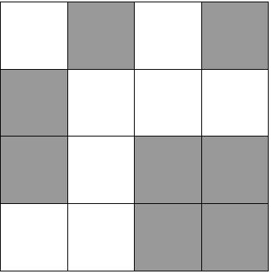
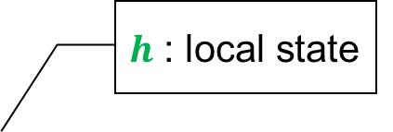
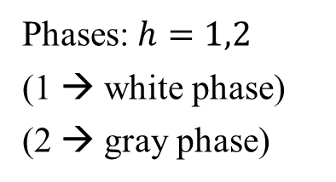
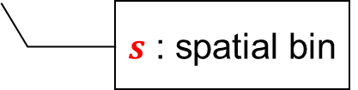
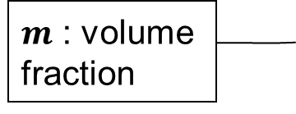
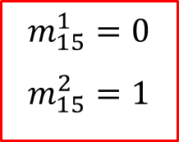


Local Microstructure Descriptor for Composites
1
5
9
13
$h$ : local state
2
6
10
14
$m$ : volume fraction
$m_{s}^{h}$
3
7
11
15
$s$ : spatial bin
4
8
12
16
$m_{s}^{h}$: volume fraction of phase h in spatial cell s
Phases: $h=1,2$
(1 → white phase)
(2 → gray phase)
$$m_{6}^{1}=1$$
$$m_{6}^{2}=0$$
$$m_{15}^{1}=0$$
$$m_{15}^{2}=1$$

Slide 3
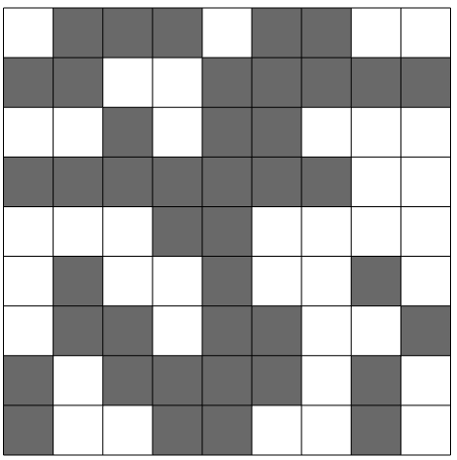
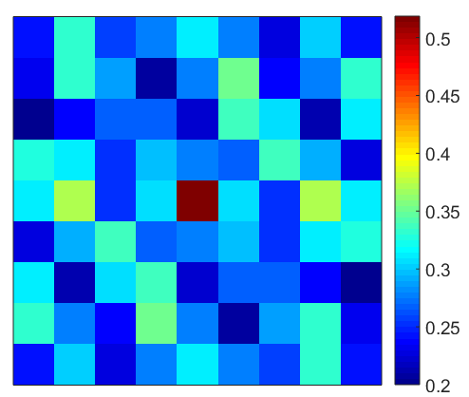
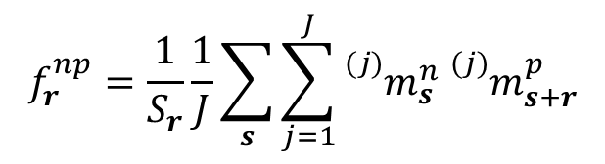
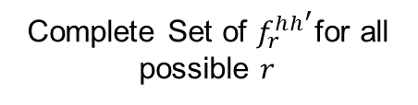

2 Point Statistics
Spatial correlations capture all of the salient measures of the microstructure
$$f_{r}^{hh^{′}}=\frac{\# Trials Successful}{\# Trials Attempted}$$
Complete Set of $f_{r}^{hh^{′}}$for all possible $r$
$$f_{r}^{np}=\frac{1}{S_{r}}\frac{1}{J}\sum_{s}{\sum_{j=1}^{J}{{{}_{}^{(j)}m}_{s }^{n}{{}_{}^{(j)}m}_{s+r}^{p}}}$$

Slide 4
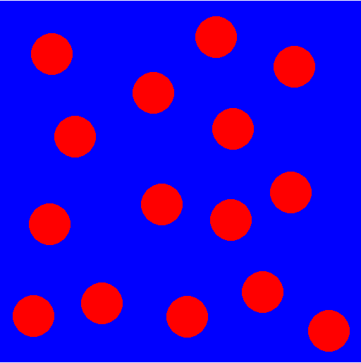
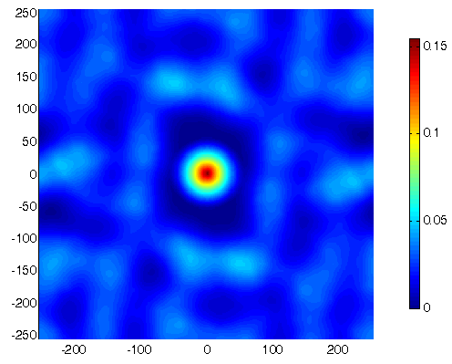
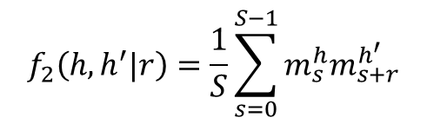
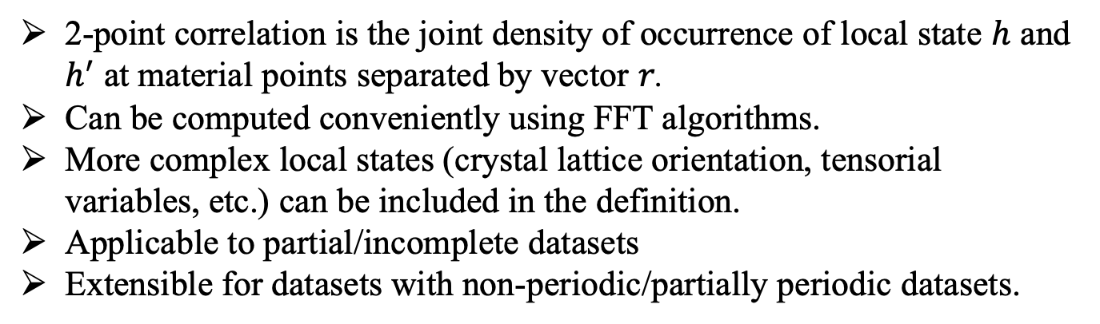
Statistical Description of microstructure
Micrograph
2-point auto correlation
$$f_{2}\left(h,h^{′}|r\right)=\frac{1}{S}\sum_{s=0}^{S−1}{m_{s}^{h}m_{s+r}^{h^{′}}}$$
2-point correlation is the joint density of occurrence of local state $h$ and $h^{′}$ at material points separated by vector $r$.
Can be computed conveniently using FFT algorithms.
More complex local states (crystal lattice orientation, tensorial variables, etc.) can be included in the definition.
Applicable to partial/incomplete datasets
Extensible for datasets with non-periodic/partially periodic datasets.

Slide 5
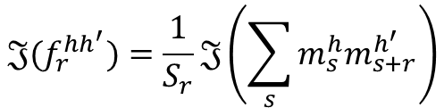
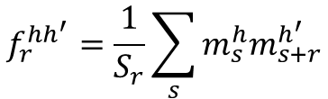


Calculation of 2 point statistics
$$f_{r}^{hh^{′}}=\frac{1}{S_{r}}\sum_{s}{m_{s}^{h}m_{s+r}^{h^{′}}}$$
Two-point statistics expression is a convolution.
$$𝔍(f_{r}^{hh^{′}})=\frac{1}{S_{r}}𝔍\left(\sum_{s}{m_{s}^{h}m_{s+r}^{h^{′}}}\right)$$
We take the FFT of both sides to take care of the summation faster than convolution in real space
$$F_{r}^{hh^{′}}=\frac{1}{S_{r}}M_{k}^{h}⨀M_{k}^{h^{′}}$$
The expression in top equation is nothing but a entry wise product in frequency space
$$f_{r}^{hh^{′}}=\frac{1}{S_{r}}𝔍^{−1}\left(M_{k}^{h}⨀M_{k}^{h^{′}}\right)$$
After the product, we take inverse FFT to go back to real space to obtain 2-point statistics.

Slide 6
Principal Component Analysis (PCA)
Objective and hierarchical identification of most characteristic features.
Features are independent and uninformed of process and property.
Original Axes
Principal Axes
Reduced Axis
p1
y
p1
p1
p2
x
p2
Obtain the first handful dimensions (out of possibly thousands or millions) that show the highest variation within the dataset.

Slide 7
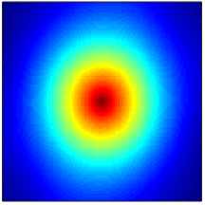
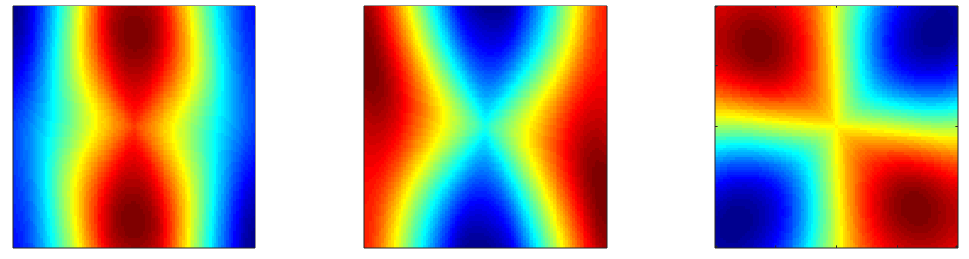




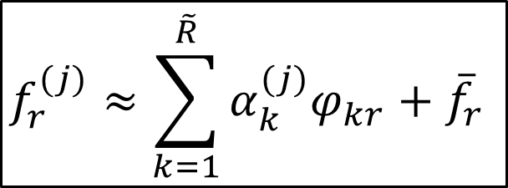

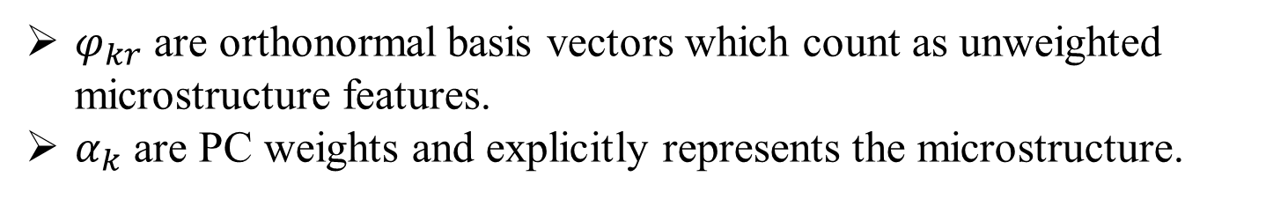



Principal Component Analysis (PCA)
$$f_{r}^{(j)}≈\sum_{k=1}^{\tilde{R}}{α_{k}^{(j)}φ_{kr}}+{\overline{f}}_{r}$$
where $\tilde{R}≪min\left(\left(J−1\right),R\right)$
$φ_{kr}$ are orthonormal basis vectors which count as unweighted microstructure features.
$α_{k}$ are PC weights and explicitly represents the microstructure.
$$f_{r}$$
$$φ_{1r}$$
$$φ_{2r}$$
$$φ_{3r}$$
$$α_{1}$$
$$α_{2}$$
$$α_{3}$$

Slide 8
Install PyMKS
$ conda install -c conda-forge pymks scikit-learn=0.19 sfepy=2017.2 toolz scipy=0.19.1 matplotlib=2.0.2
$ conda install jupyter
$ conda install dask
$ conda install -c conda-forge bqplot
Link to tutorial:

Slide 9
Documentation
Delineation of the space of 2-point correlations in a composite material system
http://www.sciencedirect.com/science/article/pii/S1359645408004886
Understanding and visualizing microstructure and microstructure variance as a stochastic process
http://www.sciencedirect.com/science/article/pii/S1359645411004654
Structure–property linkages using a data science approach: Application to a non-metallic inclusion/steel composite system
http://www.sciencedirect.com/science/article/pii/S1359645415001603
Versatile algorithms for the computation of 2-point spatial correlations in quantifying material structure
https://link.springer.com/article/10.1186/s40192-015-0044-x

